Slide 1

Department of Electronics and Communication Engineering
MUTHAYAMMAL ENGINEERING COLLEGE (An Autonomous Institution) Rasipuram - 637 408, Namakkal Dt, Tamil Nadu, India
Batch No : 10
Project Guide:
Dr.J.Kirubakaran,
Associate Professor,
Department of ECE,
Muthayammal Engineering College.
Team Members:
1. Sharmila V(23EC166)
2. Srimathi T(23EC149)
3. Vijayakumar S(23EC166)

Slide 2
Digital Energy Meter Using Arduino

Slide 3
ABSTRACT
The Digital Energy Meter is designed using Arduino UNO to measure electrical energy consumption..
Voltage and current sensors are used to monitor electrical parameters in real time
The system calculates voltage, current, and power consumption accurately..
Measured values are displayed digitally on an LCD display for easy monitoring.
The project helps in reducing power wastage and improving energy management.
The system can be upgraded with IoT technology for remote monitoring and smart billing applications.

Slide 4
LITRATURE SURVEY
Title | Author | Methodology | Limitations
Aeduino Based Digital Energy Meter for Smart Enegry Monitoring | S. Patel, M. Sharma,A.Kumar,R.Singh ,Shuolian Ding,Stavros Koulouridis. | Designed and developed a digital energy meter using Arduino UNO, voltage sensor, and current sensor to measure and display voltage, current, power, and energy consumption on an LCD display in real time | The proposed digital energy meter may face accuracy issues due to sensor calibration and electrical noise.
Digital Power Consumption Meter Using Arduino. | P.Rajkumar,Naveen,Sharma,Patel, IEEE. | The proposed system uses an Arduino UNO, voltage sensor, and current sensor to measure electrical parameters in real time. | Limited accuracy may occur due to sensor calibration errors and electrical noise during measurement.

Slide 5
Title | Author | Methodology | Limitations
Implantable Antennas for Bio-Medical Applications | Nabeel Ahmed Malik,Paul Sant,Tahmina Ajmal,Masood ur-Rehman | Reviewed and compared various implantable antenna designs for medical telemetry and in-body communication. | Biocompatibility and detuning in heterogeneous tissues remain major challenges
Performance evaluation for MIMO in vivo WBAN systems | Chao He, Yang Liu, Thomas Ketterl, Gabriel Arrobo, IEEE | Analyzed and simulated MIMO communication performance inside the human body using realistic electromagnetic models. | High tissue absorption limits achievable data rates and signal strength
Dual-Band Skin-Adhesive Repeater Antenna for Continuous Body Signals Monitoring | Jaco M .Felicio, Jorge R. Costa, Carlos A. Fernandes, IEEE | Designed a skin-conformal dual-band repeater antenna for continuous signal relay between implanted and external sensors. | Limited flexibility and reduced efficiency due to skin-air interface mismatch.

Slide 6
EXISTING SYSTEM
Traditional analog energy meters are commonly used to measure electricity consumption in residential and industrial applications.
Smart energy meters with IoT technology provide remote monitoring and automatic billing features.
Digital energy monitoring systems using microcontrollers offer improved accuracy and real-time data display.
High mutual coupling between antenna elements reduces isolation and efficiency.
Performance degrades when bent of placed on curved or irregular surfaces.

Slide 7
PROPOSED SYSTEM
The proposed system uses Arduino UNO for real-time energy monitoring and calculation.
Voltage and current sensors are used to measure electrical parameters accurately
The system calculates voltage, current, power, and energy consumption automatically
An LCD display is used to show the measured readings digitally.
The system helps users monitor electricity usage and reduce power wastage.
The proposed design is low cost, compact, and easy to implement for domestic applications.

Slide 8
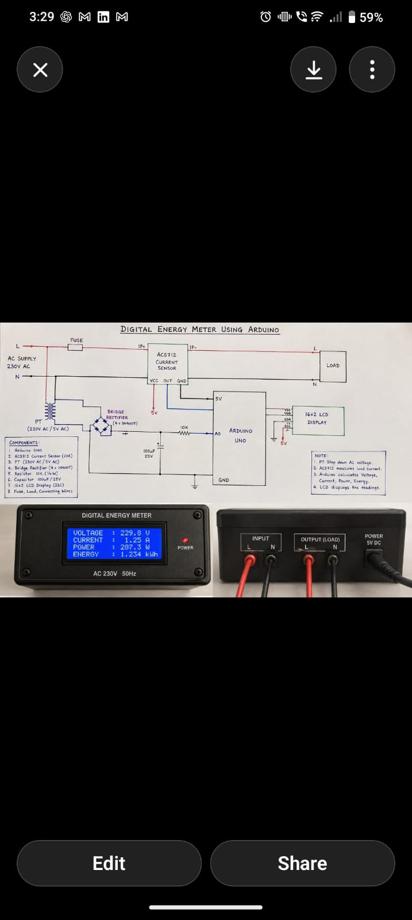
DIAGRAM
Figure 1: Circuit Diagram

Slide 9
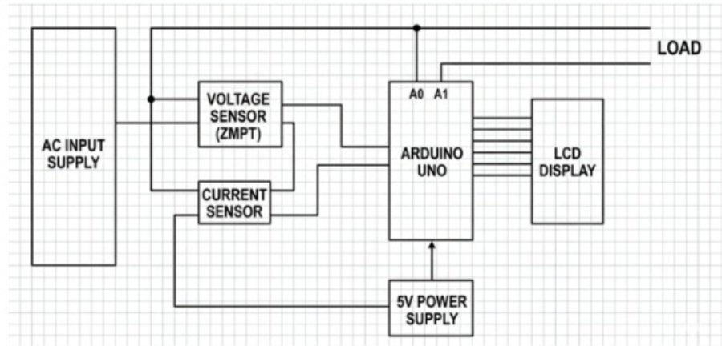
ANTENNA SUBSTRATE
Figure 3: Antenna Substrate With Fat

Slide 10
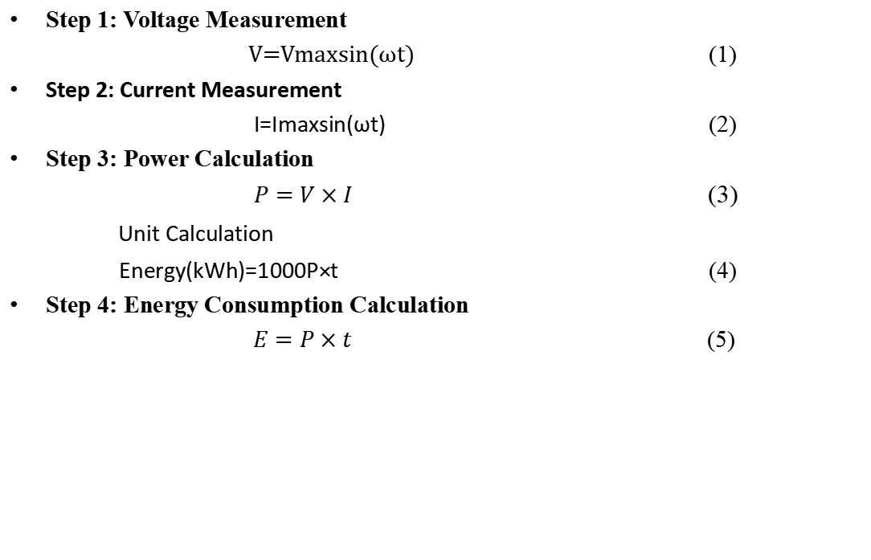
Mathematical Modeling of Seamless Geometric Pattern
Step 1: Voltage Measurement
$\text{V}\text{=}\text{Vmax}\text{​}\text{sin}\text{(}\text{ω}\text{t}\text{)}$ (1)
Step 2: Current Measurement
I=Imax​sin(ωt) (2)
Step 3: Power Calculation
$P=V×I$ (3)
Unit Calculation
Energy(kWh)=1000P×t​ (4)
Step 4: Energy Consumption Calculation
$E=P×t$ (5)

Slide 11
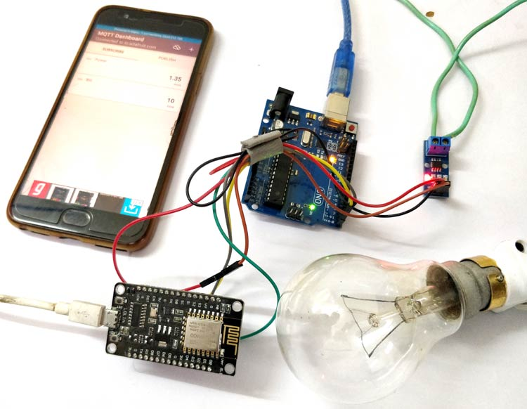
FABRICATED RESULTS
Figure 2: Real-time Setup of the Digital energy meter

Slide 12
CONCLUSION
The proposed digital energy meter successfully measures voltage, current, power, and energy consumption in real time.
Arduino UNO provides accurate processing and efficient monitoring of electrical parameters.
The LCD display enables easy and continuous observation of energy usage.
The system helps users reduce electricity wastage and improve energy management.
The proposed design is cost-effective, compact, and suitable for domestic and small-scale industrial applications.
Future enhancements such as IoT integration can enable remote monitoring and smart billing features.

Slide 13
REFERENCES
A. Kumar, R. Singh, “Arduino Based Digital Energy Meter for Smart Monitoring Applications,” International Journal of Engineering Research and Technology (IJERT), 2022.
S. Patel, M. Sharma, “Smart Energy Meter using Arduino and IoT,” International Journal of Innovative Research in Science and Engineering, 2021.
P. Rajkumar, K. Naveen, “Real-Time Power Monitoring System using Arduino,” IEEE International Conference on Smart Systems, 2023.
M. Kumar, D. Prakash, “Digital Power Consumption Measurement using Embedded Systems,” International Journal of Electronics and Communication Engineering, 2020.

Slide 14
Arduino Official Documentation, “Arduino UNO Rev3 Technical Specifications.” Arduino UNO Documentation
Allegro Microsystems, “ACS712 Fully Integrated Hall Effect-Based Linear Current Sensor IC Datasheet for Current Measurement Applications,” Allegro MicroSystems LLC, 2021. ACS712 Sensor Datasheet and Technical Details
Atmel Corporation, “ATmega328P 8-bit AVR Microcontroller with 32K Bytes In-System Programmable Flash: Technical Reference and Hardware Specifications,” Microchip Technology Inc., 2020. ATmega328P Complete Technical Datasheet

Slide 15
Thank You

